Slide 1

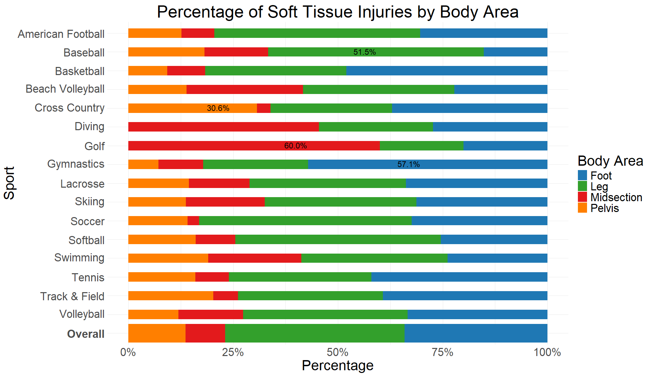
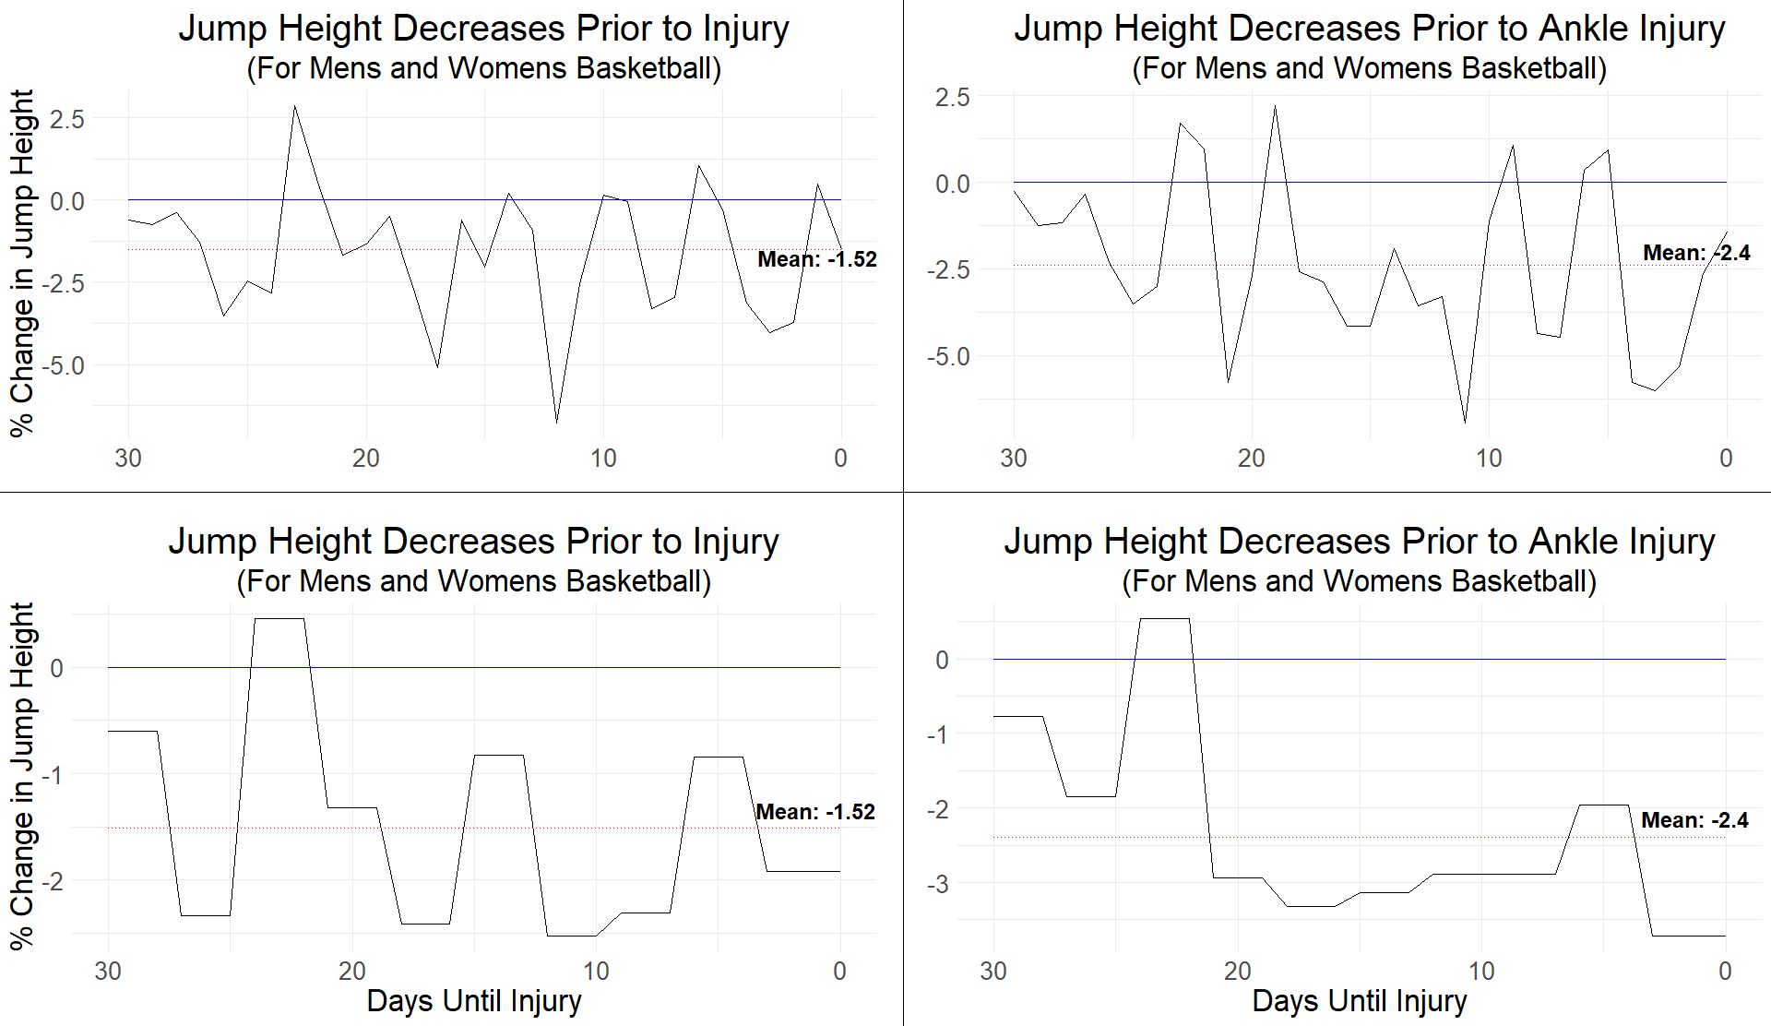
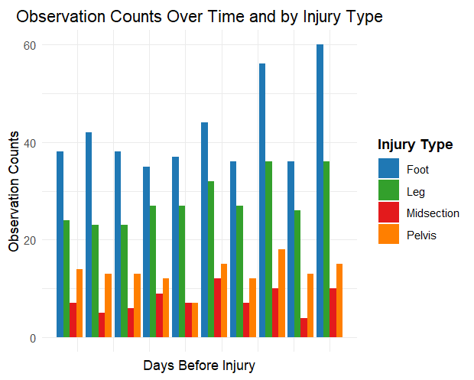
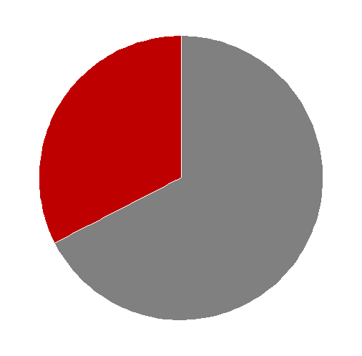
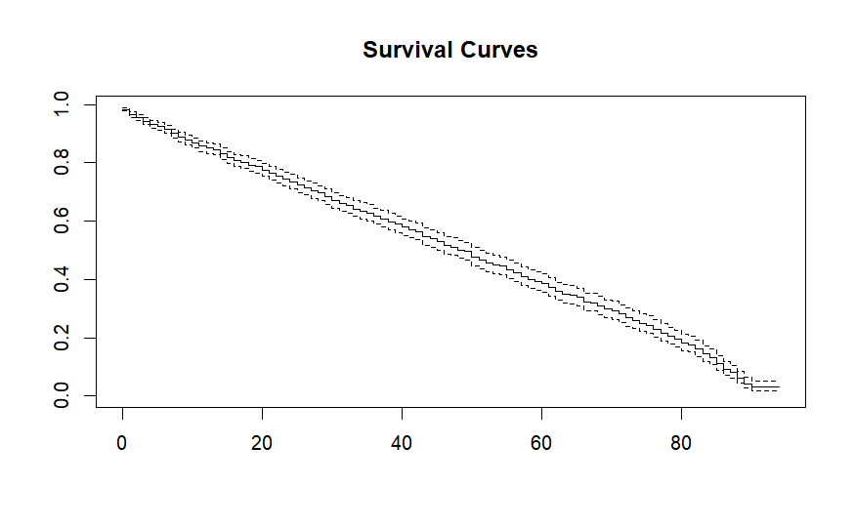
Exploring Relationships between Lower Body STI and Force Plate Performance
Beverly Albert, Parker Booth, & Isaac Clark
Introduction
Results
Limitations
Contact:
32.56%
Other:
67.44%
Lower body soft tissue injuries (STI) make up approximately 60% of all injuries across sports.
Lower body STIs are defined as injuries that involved damage to the muscles, ligaments, and tendons from the midsection down.
Double-leg countermovement jump testing using force plates is widely available, relatively inexpensive, easy to test, and collects a variety of movement characteristics.
Reseach Questions:
Which force plate counter movement jump characteristics are related to lower body STI?
Can injuries be anticipated using force plate data?
Will these insights aid in injury prevention?
Preliminary exploratory analysis and literature review revealed little about possible connections between force plate metrics and lower body STIs.
One research paper found that that only 8% of countermovement jump studies observed an association with injury risk. ^{[1]}
Another paper found no significant associations between the force plate vertical jump scores and the likelihood of experiencing either an MSKI or a lower extremity MSKI. ^{[2]}
The number of observations of injuries and force plate tests were low for some sports.
Contact STIs represented approximately one-third of all observed injuries.
The randomness of contact injuries introduces excess variability.
Variations in injury reporting.
Not controlling for landings on jumps restricted the use of other potentially relevant metrics for predicting injuries. ^{[1]}
In single sport analysis, relationships between force plate characteristics and injuries were weak and inconsistent.
When comparing within sports groups, these relationships disappeared.
The strongest relationship within groups is highlighted in the chart above.
Correlation and linear relationship analysis returned near-zero results for most sports and injuries.
Statistically significant relationships that were further investigated by grouping similar sports once again yielded no results.
Ankle injuries had the most significant results and the most observations.
Looking Forward
Analyzing contact injuries separately could help remove some variation and provide more concrete results.
Incorporating other data sources from different technologies, such as wearable IMUs, could provide added insight.
This would allow for comparisons with variables such as training load or decelerations.
Previous research found players were 50-80% likely to sustain a preseason injury within a training load range of 3,000-5,000 units. ^{[3]}
Controlling for landings in countermovement jumps or analyzing drop jumps could help determine relationships using different characteristics.
Is it still possible to predict injuries using other methods of analysis and testing characteristics?
COX-PH Survival Model
Coefficients for jump height and flight time were not statistically significant and were trending in opposite directions.
All other built-in model checks did not meet statistical significance thresholds.
Methods
All force plate data was collected using double-leg countermovement jumps
Injury timeframes were specified as a 6-month period leading up to injury.
Sports were grouped by similar demands for analysis.
Two Field Sports; Two Court Sports.
These relationships were compared using data from force plate jumps collected in the month preceding an injury event, to the average jump results from the previous five months.
A Cox-PH model analysis was conducted on Court Sport Injuries.
Baseline values for athletes were the first 3 months of the injury timeframe.
Jump height and flight time test results from the 3 months prior to injury were compared to baseline values.
References
Conclusions
[1] Pedley, J. S. (2020) Utility of kinetic and kinematic jumping and landing variables as predictors of injury risk: A Systematic review. Journal of Science in Sport and Exercise
[2] Hando, B. R. (2022) The use of force plate vertical jump scans to identify special warfare trainees at risk for musculoskeletal injury: a large cohort study. The American Journal of Sports Medicine
[3] Gabbett, T. J. (2010) The development and application of an injury prediction model for noncontact, Soft-Tissue injuries in elite collision sport athletes. The Journal of Strength and Conditioning Research
Statistical models did not substantiate relationships between force plate characteristics and lower body STIs.
Countermovement jump characteristics are not a direct indicator of injury.
Related literature supports the conclusion against a direct relationship between countermovement jump characteristics and lower body STIs. ^{[1] [2]}

